Slide 1

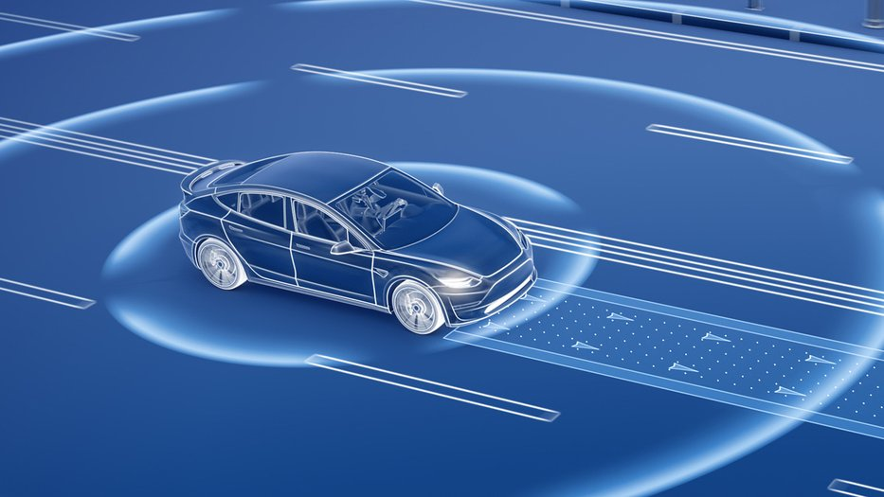
Wireframe-Based Pothole Detection and Avoidance System
BATCH - 02
Guided by: Dr SURESH KUMAR
Presented by MOHAMED B SIRAJUDDEEN (22TD0053)

Slide 2

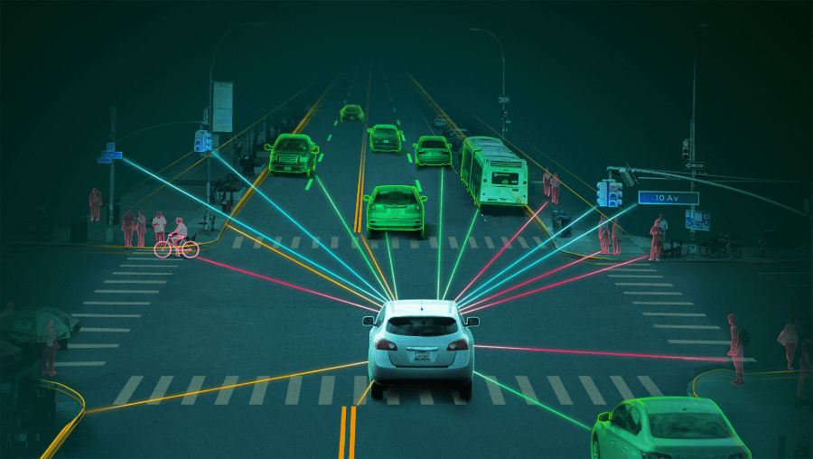
Agenda
01
05
Introduction
Architectural Structure
02
06
Domain & Sub-Domain
Research Survey
03
07
Objectives
Conclusion
04
Existing Work

Slide 3
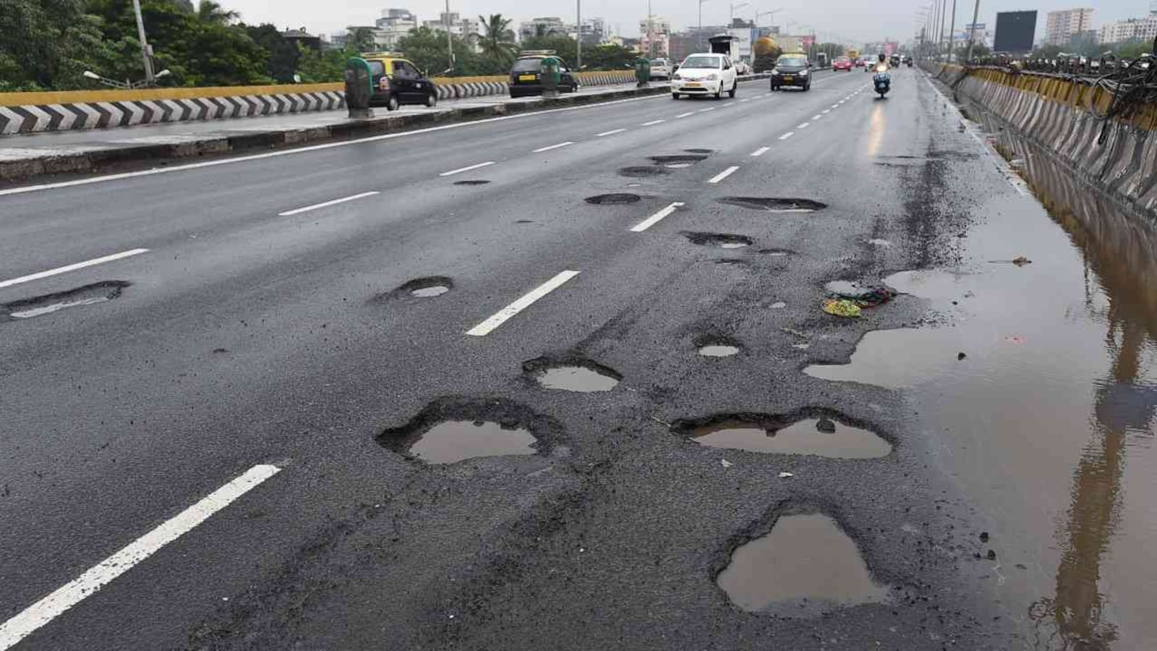
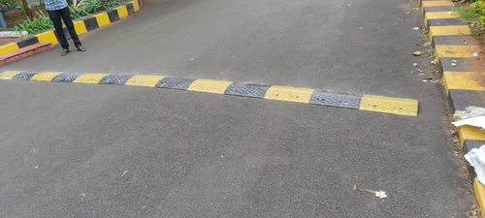
Introduction
Autonomous vehicles (AVs) rely on object detection and navigation systems optimized for structured and well-maintained roads.
In countries like India, road infrastructure is often inconsistent, featuring frequent potholes, speed bumps, and surface deformities.
Standard AV systems struggle to operate reliably in such conditions, impacting safety and ride quality.
Surface anomalies reduce ride comfort and can be significant safety hazards.
Conventional solutions using LiDAR and high-end sensors are expensive and not suitable for mass deployment.
There is a pressing need for a cost-effective, camera-based solution capable of detecting, analyzing, and responding to road surface anomalies in real-time.

Slide 4


Domain & Sub-Domain
Artificial Intelligence
Focuses on building systems that mimic human intelligence.
Involves machine learning, deep learning, computer vision, and decision-making.
Enables machines to perceive, learn, adapt, and take actions autonomously.
Key techniques used in this project:
Object Detection (YOLOv8)
Monocular Depth Estimation (MiDaS)
3D Reconstruction (Open3D)
Rule-Based Decision Systems Autonomous Vehicles
Applies AI techniques to enable self-driving or driver-assistive vehicles.
Combines perception, localization, path planning, and control.
Addresses real-time environmental sensing and decision-making for safe navigation.
Specific focus in this project:
Real-time road surface anomaly detection
Depth-aware vehicle behavior (slow, avoid, alert)
Low-cost AV sensor alternatives for developing regions
Camera-based road understanding for poor infrastructure

Slide 5

Problem
Statement
Identify the core issue your project or study addresses. Describe the challenge your project focuses on, highlight its scope and impact, and briefly discuss why it matters.

Slide 6

Why it matters
If relevant, include statistics, quotes, or citations to support the problem’s significance.
100%
7 million
Description of the featured statistic
Description of the featured statistic

Slide 7




Goals and Objectives
Goal or objective here
Goal or objective here
Goal or objective here
Give a brief description of your project goal or objective here.
Give a brief description of your project goal or objective here.
Give a brief description of your project goal or objective here.

Slide 8
Tools and Methodology
Tool or technology here
Describe any tools, software, or platforms you used to complete the project.
In this section, describe your approach to the project. Have you followed any specific steps? Is it qualitative or quantitative research? Keep this section brief, limiting it to just one or two paragraphs.
Tool or technology here
Describe any tools, software, or platforms you used to complete the project.
Tool or technology here
Describe any tools, software, or platforms you used to complete the project.

Slide 9

Findings and Results
Show the audience what your project has achieved, discovered, or produced.

Slide 10
Key Findings
Finding or result here
Finding or result here
Finding or result here
Briefly discuss the outcome of your research or project.
Briefly discuss the outcome of your research or project.
Briefly discuss the outcome of your research or project.

Slide 11
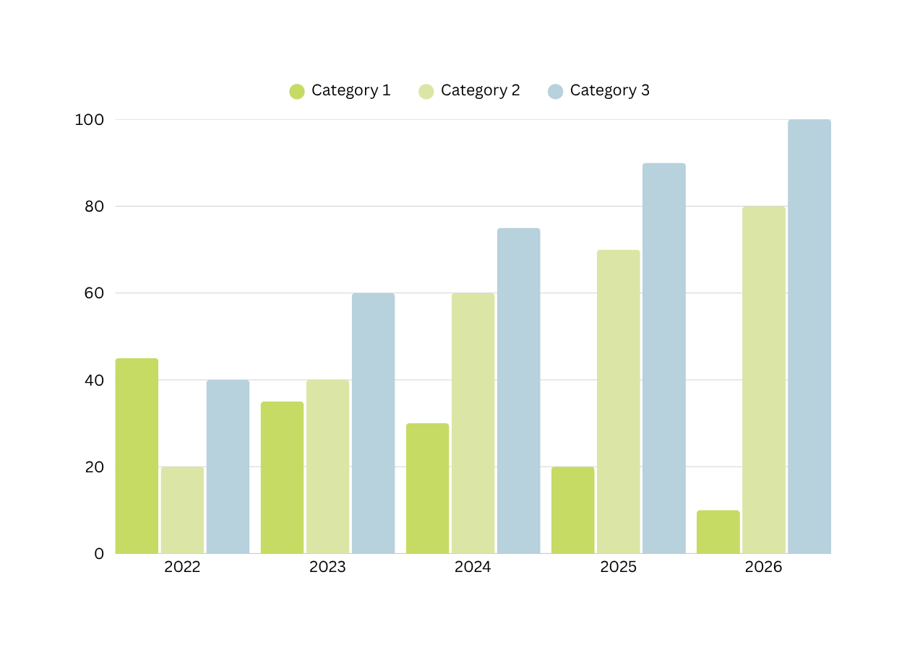
Chart title here
If applicable, use a chart or table to visualize your results or highlight comparisons. Use this section to briefly explain what the results mean.

Slide 12

Conclusion
Reflect on your project's impact and discuss how it relates to your initial goals or problem statement.

Slide 13

Summary of key points
Key point here
Briefly reflect on your key point or takeaway here.
Key point here
Briefly reflect on your key point or takeaway here.
Key point here
Briefly reflect on your key point or takeaway here.

Slide 14
Reach out
Email
Phone
hello@reallygreatsite.com
123-456-7890
Social media
Address
@reallygreatsite
123 Anywhere St., Any City, ST

Slide 15
Resource Page
Use these in your presentation. Delete or hide this page before presenting.
Fonts
Design Elements / Icons
This presentation template
uses the following free fonts:
TITLES:
Raleway
BODY TEXT:
Inter
You can find these fonts online too.
Colors
#C6DB63
#DBE6A6
#FBFFE7
#B7D1DD
#FFFFFF

Slide 16

Credits
This presentation template is free for everyone to use, thanks to the following:
Pexels, Pixabay, Sketchify
for this presentation template
for the photos, graphics, and elements
Happy designing!

